Slide 1
Employee Relations
Pages 240 – 261

Slide 2
Employee Relations
The relationship that exists between employers and employees and how they work together to determine the level of pay and working conditions. This also includes spelling out the obligations employees have to their employers and vice versa.
(Diagram on next slide)

Slide 3
Employee Relations
Outcome:
Negotiated
pay and
conditions
Employers
Want:
Productivity
Low costs
Flexibility
Employee
Wants:
Good pay
Fair conditions
Job security

Slide 4
Employee Relations
The aim of ER is to achieve an optimum working relationship between the employees of an organisation and management.
This will in turn lead to optimum productivity and greater organisational competitiveness.

Slide 5

Employee Relations Issues
Job classifications
Award conditions
Leave entitlements
Unfair dismissal
Anti-discrimination
Dispute resolution
Contract provisions

Slide 6
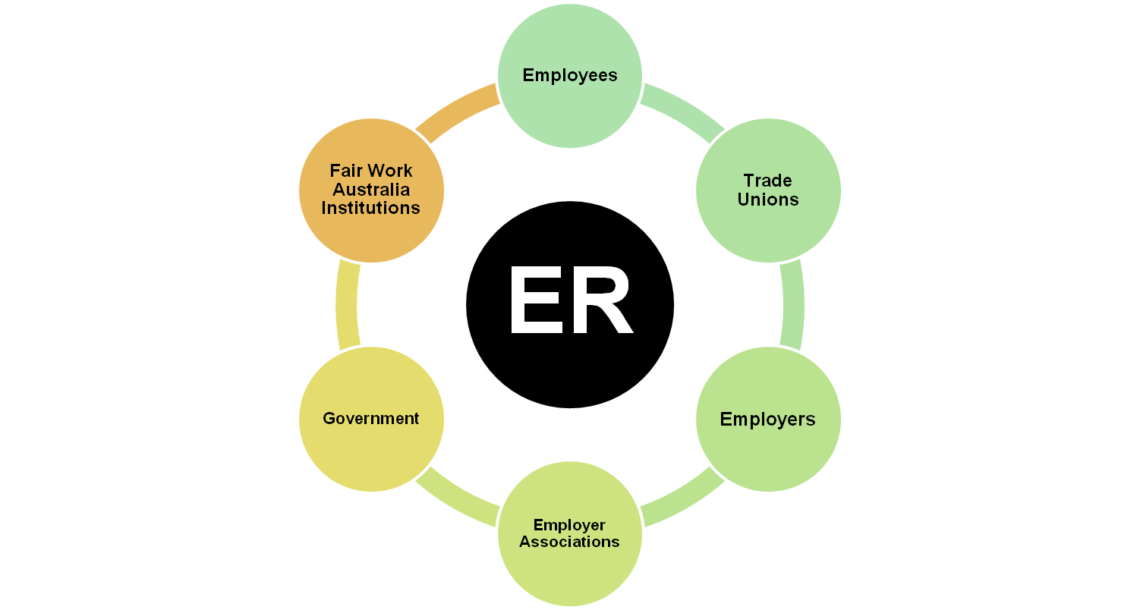
Participants in ER

Slide 7
Government
The federal government has an enormous influence on Australian employee relations through passing a range of laws. Such legislation relates to:
  OH&S
  Employee contracts
  Pay
  Taxation

Slide 8
Employers &
Employer Associations
Employer associations – groups of employers who come together to promote their common interest in ER, offer support and share information. The provide advice to employers and represent their interests on ER issues.

Slide 9
Types of Employer Associations
Industry Associations
Professional Associations
Peak Bodies

Slide 10
Fair Work Australia Institutions
Fair Work Australia – A one stop shop for information, advice and assistance on workplace issues.
It has the power to:
  Vary awards
  Make minimum wage orders
  Approve agreements
  Determine unfair dismissal claims

Slide 11

Structure of FWA
President
Deputy Presidents
Commissioners
Minimum Wage Panel Members

Slide 12
Fair Work Ombudsman

Slide 13
Fair Work Divisions

Slide 14
Employees & Trade Unions
Trade Union – An organisation formed to represent and protect the rights of workers in a particular industry.

Slide 15
Industrial Relations Systems
Centralised Vs. Decentralised
Prior to 1991
1991 – 2010

Slide 16
Centralised System
Where awards (pay and working conditions) were determined by a central body (AIRC) relating to an industry.
Awards are industry specific documents that outline the minimum wages and conditions for occupations.

Slide 17
Australian Industrial Relations Commission
In place to facilitate agreement on wages and conditions of employment between employers, employees or unions.
Establish and maintains a safety net of fair minimum wage and conditions, prevents and settles industrial disputes and unfair dismissal claims by way of conciliation and/or arbitration.

Slide 18
Decentralised System
Where employers and employees at each workplace determine their pay and working conditions and work through their differences without outside interference.

Slide 19
Categories of Agreements
Award:
  An agreement which sets out minimum terms and conditions of employment relating to an industry.

Slide 20
Enterprise Bargaining Agreement (EBA):
  The formal agreement which results from the enterprise bargaining process.
  Enterprise bargaining is the direct negotiation of working conditions and remuneration, which takes place between an employer and its employees at a particular workplace.

Slide 21
Australian Workplace Agreement (AWA):
  An agreement made directly between an employer and employee covering working conditions and remuneration.
Collective Bargaining Agreement:
  EBAs which result from negotiations between an employer and union (employees) and are registered by the AIRC.
  They suit large workplaces where the time involved in negotiating separate contracts for all workers would be too great.

Slide 22
Industrial Disputes
According to the ABS, an industrial dispute is a state of disagreement over a particular issues or group of issues between an employer and its employees, that results in employees ceasing work.
An industrial dispute may result in industrial action being taken such as strikes, boycotts or go-slows organised by the employees or lockouts arranged by the employer.

Slide 23
Positive Effects of ER
Harmonious workplace
Productive workplace
Motivated staff
Employee commitment & loyalty

Slide 24
HR & Employee Relations
HR managers must be aware of the legal IR requirements in relation to all matters to do with staffing.
HR managers will have varied employee relations responsibilities depending on the organisation.

Slide 25
It is the role of the HRM department to:
  Negotiate with employees
  Act as an intermediary between employees and senior management

Slide 26
HR Skills in ER
A HR manager needs a range of skills in relation is ER. These include:
  Negotiation skills
  Conflict resolution skills
  Communication skills
  Analytical skills

